Slide 1
Wildfire Damage Mitigation:
Predictive Machine Learning Models for Wildfire Severity Classification
Final Presentation
Jason Widjaja Djuandy, Nail Enikeev, Nassim Ali-Chaouche, Rohini Sidharth Kulkarni
Team 2 / DATA270 - Data Analytics Process
Dr. Ming-Hwa Wang

Slide 2
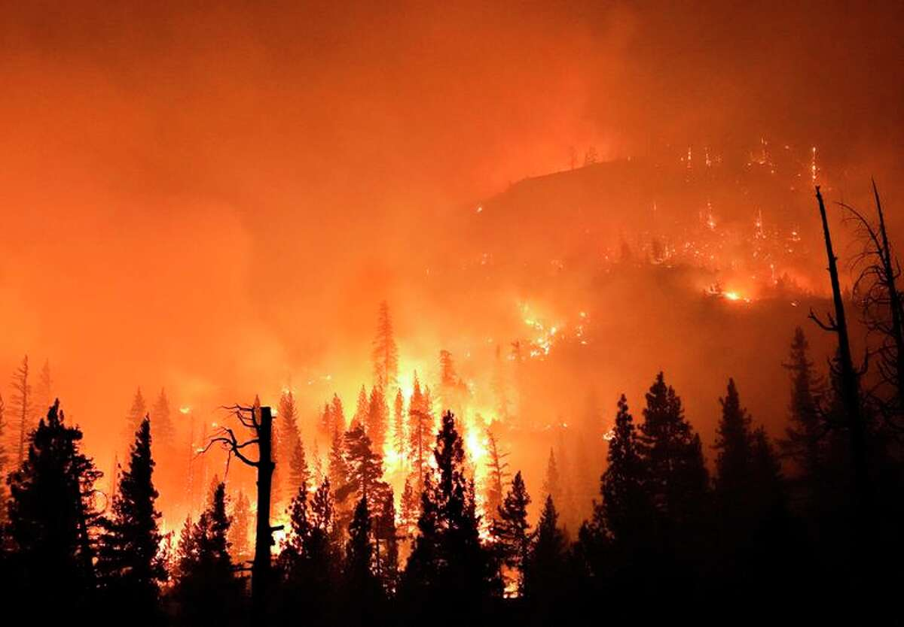
Motivation
Wildfire Impact and Damage:
Health
Suffocation
Burns
Weather -
Releases large amount of Carbon Dioxide and Carbon Monoxide
Air pollution
Environment
Economic effect
Property Loss
Reference: https://www.britannica.com/science/wildfire

Slide 3

Problem
Climate Change → Temperature Rise → Drier Conditions →
Longer and More Active Fire Seasons → Wildfires become more Prevalent
(National Oceanic and Atmospheric Administration)
How to deal with increased likelihood of Wildfires?

Slide 4

Plan
Using Historical Data on Wildfires and Factors of Wildfire Spread:
Devise a severity metric which ranks the severity of wildfires based on the number of acres burned
Initial weather conditions, drought, vegetation, and topographical data
Train a model to be able to classify severity of wildfires by using the severities found in the historical data
Application:
Severity Classification can be used by first responders in crisis management in the event of multiple wildfires happening at once.

Slide 5
Survey Author | Solution | Method | Models | Results
Liang et al. (2019) | Wildfire Scale Prediction in Canada | Scale of Level 1,2,3,4,5 based on area burned and duration | BPNN, RNN, LSTM | LSTM accuracy 90.9%, AUC of 0.942
Jiang et al. (2021) | Predict wildfire risk based on environmental factors | Divided CA into a few thousand grids, predicted risk for each grid | Multi-Layer Neural Networks (MLNN), Logistic Regression, SVM, and Random Forest | MLNN accuracy of 64.5%
Huot et al.(2022) | Next Day Wildfire Spread | Remote-sensing data for one-day wildfire prediction | Deep Learning Models, Non-Deep Learning Models,Logistic Regression, Random Forest | Neural Network AUC(PR) is 28.4 % , Precision is 33.6%, Recall is 43.1%.

Slide 6
Survey Author | Solution | Method | Models | Results
A. S. Mahdi and S. A. Mahmood et al.(2022) | Deep Learning Methods for Early Wildfire Detection | Fire detection methods based on Computer Vision systems | Convolutional Neural Networks (CNN), Recurrent Neural Networks (RNN), Deep Belief Networks (DBN) | Deep CNN Accuracy is 90.7%
Zope et al. (2020) | Wildfire Intensity Prediction | Use IoT for real time data for prediction. Scaled in Low, Medium, High and Very High | Dense Neural Network | Validation Accuracy of 91%
Girtsou et al. (2021) | Next Day Wildfire Prediction | Gridded Map of Greece and shows probability for each grid | Shallow neural network, RF, XGBoost, Logitboost | 96% Recall for RF and 97% Recall for NN

Slide 7
Team 2 Solution
Solution:
Wildfire Severity Classification for California Fires based on initial meteorological and topographical data
Method:
Rank Wildfires Into Classes A-F (Explained later)
Use Weather, Vegetation, Drought, Elevation, Slope Data
Models:
K-NN, SVM, RF, XGBoost, AdaBoost, ANN
Results:
Discussed at the end

Slide 8
Data Collection, Pre-Processing, and Transformation Steps
Data Collection from different sources
Aggregating the multiple datasets based on certain attributes (latitude, longitude, date)
Data Cleaning such as getting rid of irrelevant features, incorrect data and imputing data when possible
Devise Severity Metric to rank each wildfire from the “Acres Burned” Column
Use Variance Inflation Factor for feature selection
Normalize the predictor variables using Min-Max scaling

Slide 9
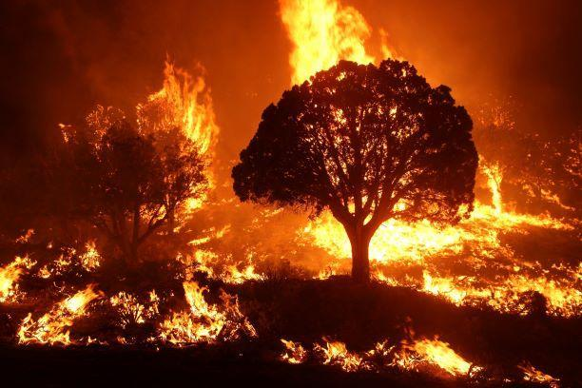
Data Sources
Historical Data:
California Wildfire Incidents Data from Cal Fire
Factors which can affect the wildfire spread in terms of area and speed:
Weather - Visual Crossing API
Drought Index (PDSI) - gridMET from Climatology Lab (file download)
Vegetation Index (NDVI) - NASA (Google Earth Engine API, NASA MOD13A1.061 Terra Vegetation Indices 16-Day Global 500m)
Elevation / Slope - NASA (Google Earth Engine API, USGS/SRTMGL1_003 dataset)
https://en.wikipedia.org/wiki/Wildfire#/media/File:Burnout_ops_on_Mangum_Fire_McCall_Smokejumpers.jpg

Slide 10

Data Transformation: Severity Classification
Severity Classification Methods based on Acres Burned
National Wildfire Coordinating Group Classification
Class A → Between one-fourth acre but less than 10 acres
Class B → Between 10 and 100 acres
Class C → Between 100 and 300 acres
Class D → Between 300 and 1000 acres
Class E → Between 1000 and 5000 acres
Class F → 5000 acres and up

Slide 11
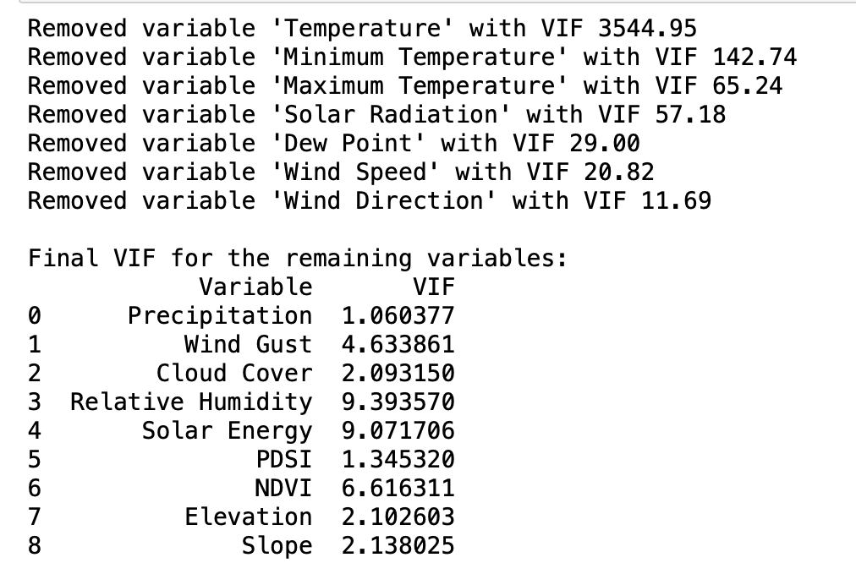
VIF values of dropped variables at each iteration and the VIF of the remaining variables
Note. A variance inflation factor (VIF) is a measure of the amount of multicollinearity in regression analysis

Slide 12
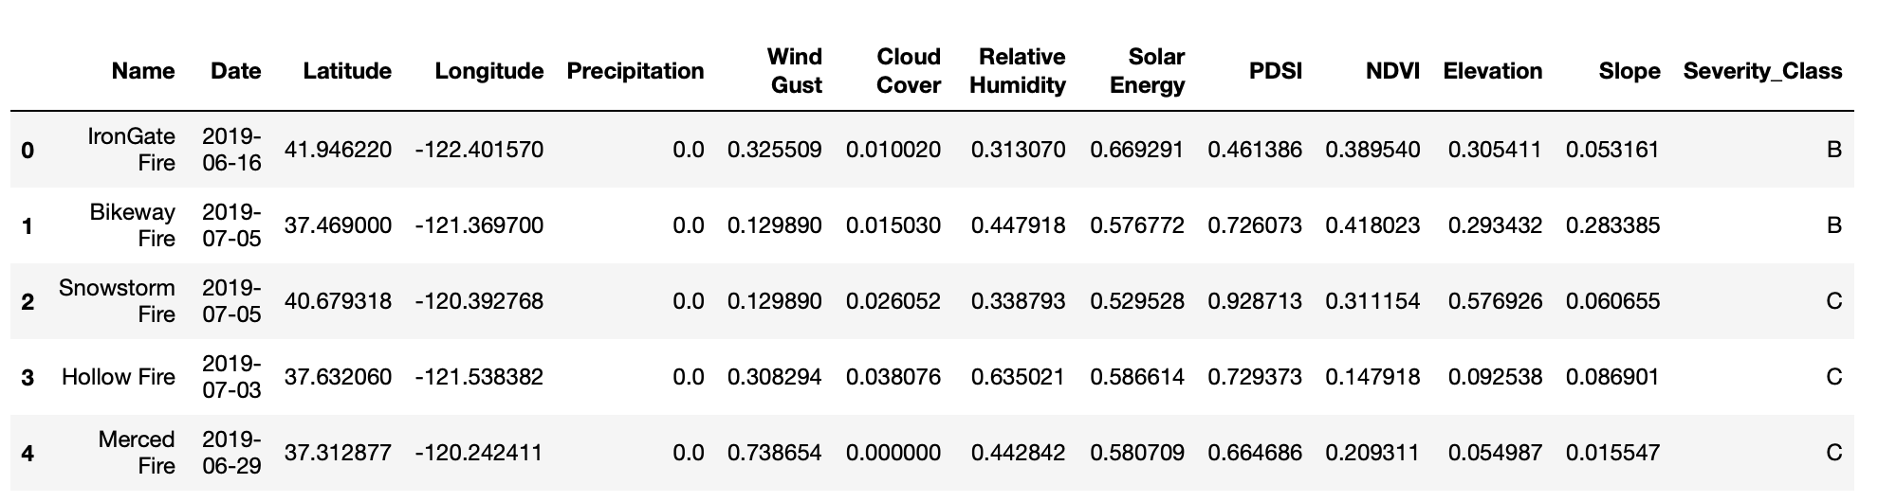
Dataset Post Normalization and Feature Reduction

Slide 13
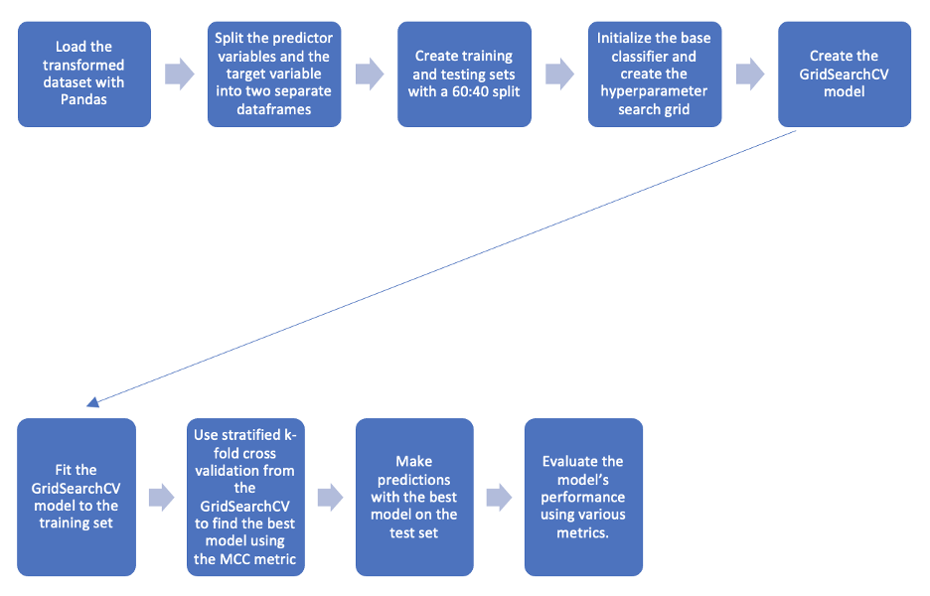
Machine Learning Modeling Process

Slide 14
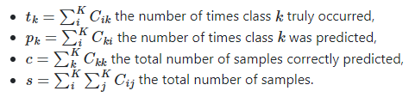

Model Evaluation Methods: MCC
Matthews Correlation Coefficient:
Takes into account true and false positives and negatives and is generally regarded as a balanced measure which can be used even if the classes are of very different sizes.
-1 = Inverse Classification
0 = Random Classification
1 = Perfect Classification

Slide 15
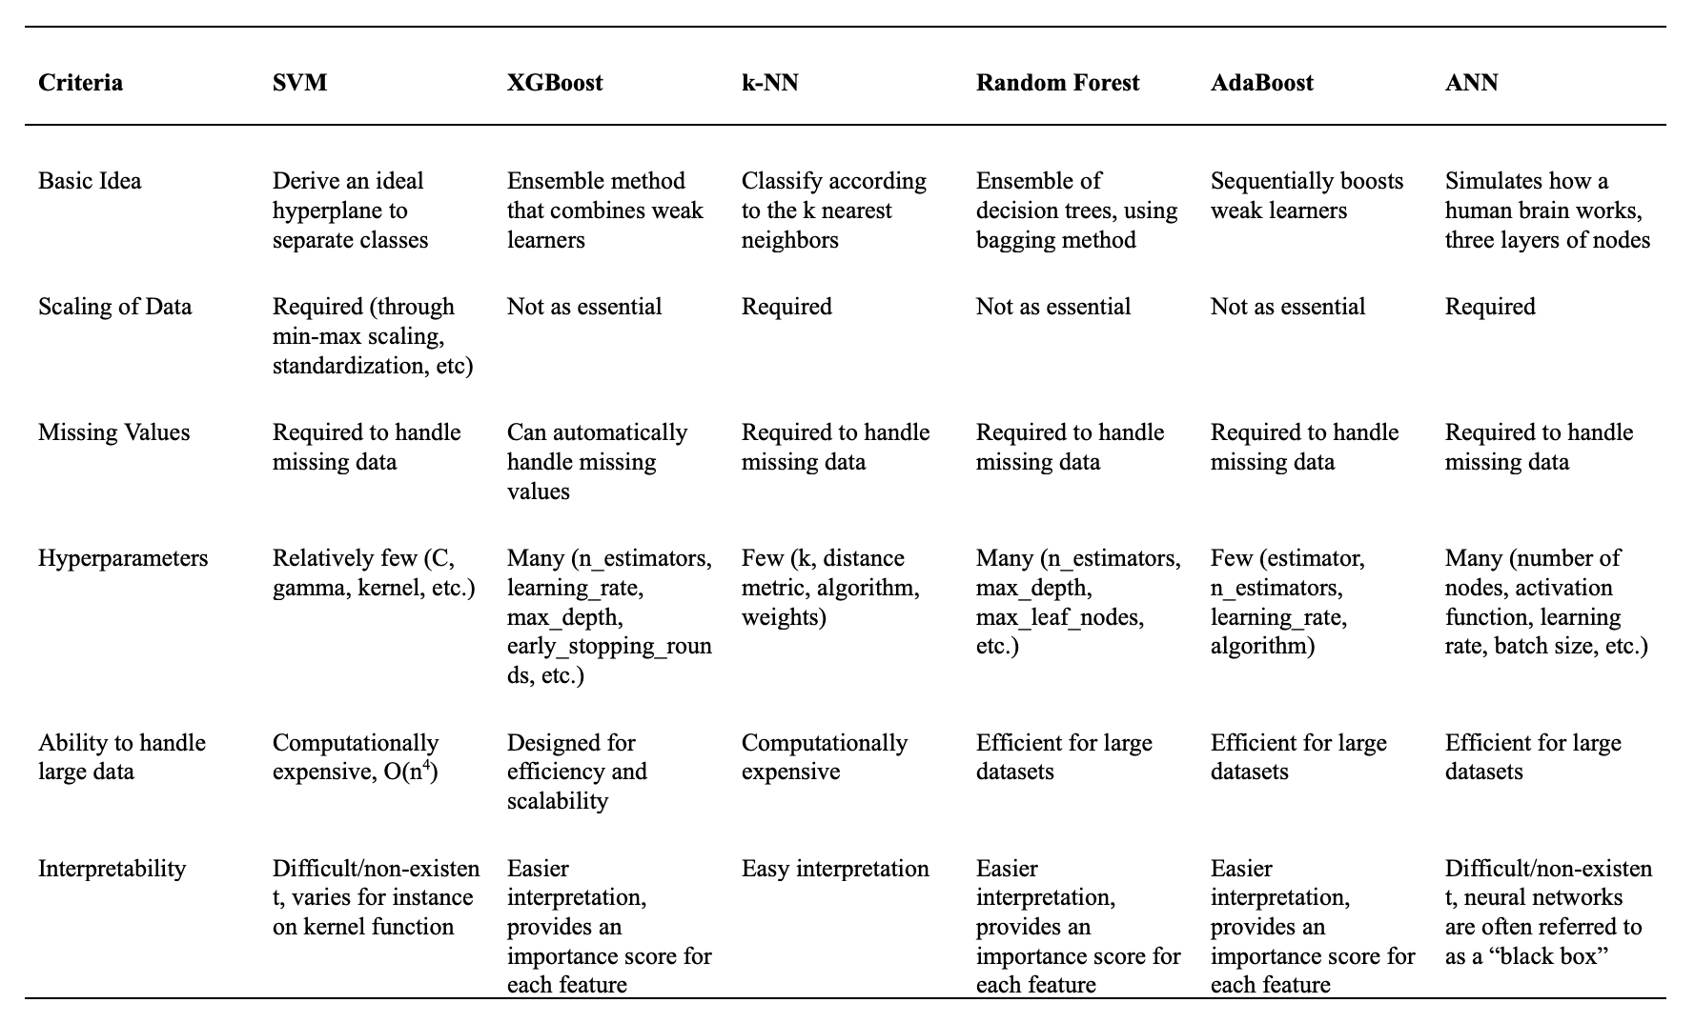
Comparison of Every Model

Slide 16
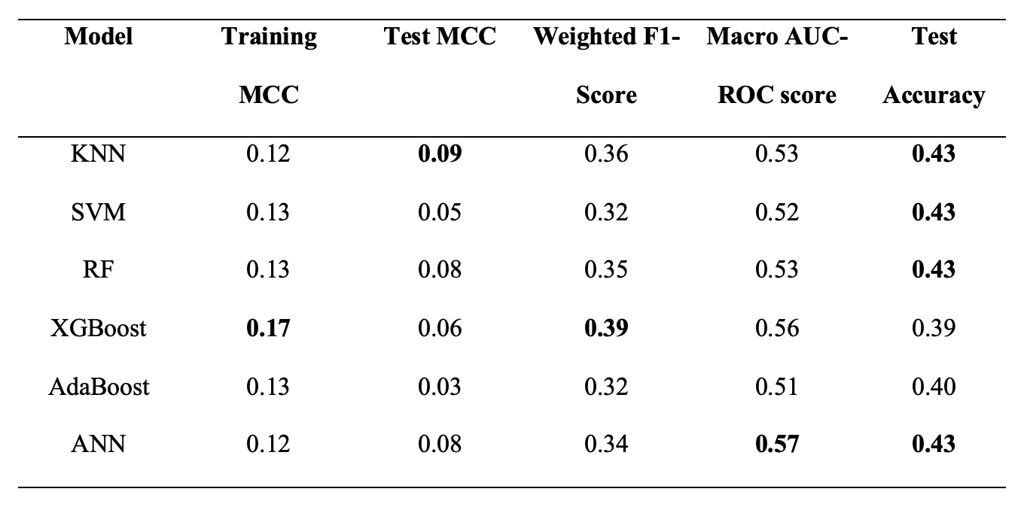
Summary of the performance of the different models with various evaluation metrics

Slide 17
Conclusion
Collected and Aggregated
Historical wildfire data from CAL FIRE
Weather, Vegetation, Drought, Topography (Elevation & Slope)
Cleaned and Transformed the merged dataset
Assigned Severity Metric for each Wildfire (Classes A→F)
Model development
KNN, SVM, RF, XGBoost, AdaBoost and ANN
Optimized Model
Stratified K-Fold Cross Validation
Grid Search (MCC Metric)
Result:
All models slightly better than a random classifier. ANN with the second highest MCC (by a small margin) and highest AUC score seems to be a marginally better model choice.

Slide 18
Future Scope
Include larger amount of data.
Gather wildfire data from other sources for future models.
Use neighboring locations
Include more predictor variables
Land Cover - Type of land that is present in the area, for instance evergreen needleleaf forests versus deciduous needleleaf forests
Try other severity classifications
Different:
Augmentation techniques to combat the imbalance of the target feature
Models with different hyperparameter combinations should be explored as these models may yield better results.

Slide 19
References
A. S. Mahdi and S. A. Mahmood, "Analysis of Deep Learning Methods for Early Wildfire Detection Systems: Review," 2022 5th International Conference on Engineering Technology and its Applications (IICETA), Al-Najaf, Iraq, 2022, pp. 271-276, doi: 10.1109/IICETA54559.2022.9888515.
Girtsou, S., Apostolakis, A., Giannopoulos, G., & Kontoes, C. (2021). A machine learning methodology for next day wildfire prediction. 2021 IEEE International Geoscience and Remote Sensing Symposium IGARSS. https://doi.org/10.1109/igarss47720.2021.9554301
Huot, F., Hu, R. L., Goyal, N., Sankar, T., Ihme, M., & Chen, Y.-F. (2022). Next day wildfire spread: A machine learning dataset to predict wildfire spreading from remote-sensing data. IEEE Transactions on Geoscience and Remote Sensing, 60, 1–13. https://doi.org/10.1109/tgrs.2022.3192974
Jiang, T., Bendre, S. K., Lyu, H., & Luo, J. (2021). From static to Dynamic prediction: Wildfire risk assessment based on multiple environmental factors. 2021 IEEE International Conference on Big Data (Big Data). https://doi.org/10.1109/bigdata52589.2021.9672044
Liang, H., Zhang, M., & Wang, H. (2019). A neural network model for wildfire scale prediction using meteorological factors. IEEE Access, 7, 176746–176755. https://doi.org/10.1109/access.2019.2957837
https://www.noaa.gov/noaa-wildfire/wildfire-climate-connection
Zope, V., Dadlani, T., Matai, A., Tembhurnikar, P., & Kalani, R. (2020). IOT sensor and Deep Neural Network based wildfire prediction system. 2020 4th International Conference on Intelligent Computing and Control Systems (ICICCS). https://doi.org/10.1109/iciccs48265.2020.9120949

Slide 20
Thank You

